Slide 1


Final Presentation
Presenter: Nguyễn Công Hậu
Mentor: Võ Tiến Dũng

Slide 2
INFORMATION
Mentor: Vo Tien Dung
Intern : Nguyen Cong Hau
Group : DG4
Project: Website to book medical appointment
Target : Complete the internship, learn to hone your programming skills, improve yourself, and experience the real working environment

Slide 3
Content
Introduction Technology Used In Project
Project function description & Lesson learned
Demo Project

Slide 4
1.
INTRODUCTION Technology

Slide 5

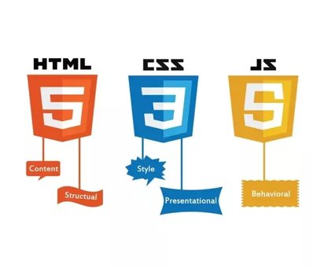


TECHNOLOGY

Slide 6
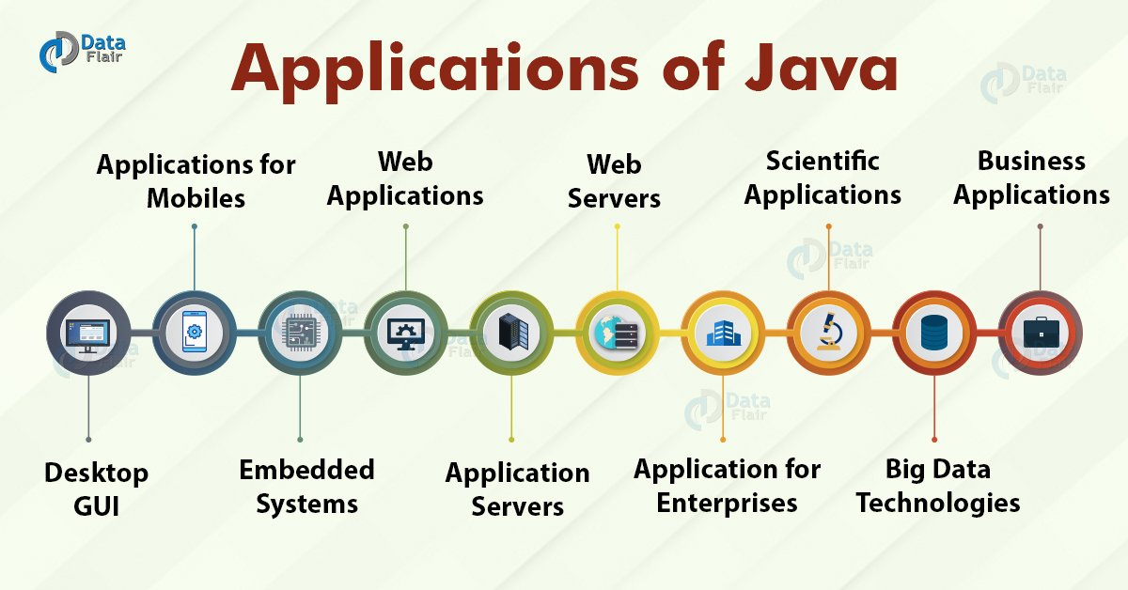

Slide 7
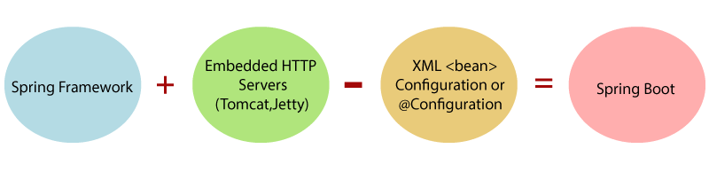
What is Spring Boot ?
Spring Boot is a module of the Spring Framework
Spring Boot is used to create standalone applications based on Spring.
It is a standard for software design configuration
Spring Boot does not require XML configuration

Slide 8
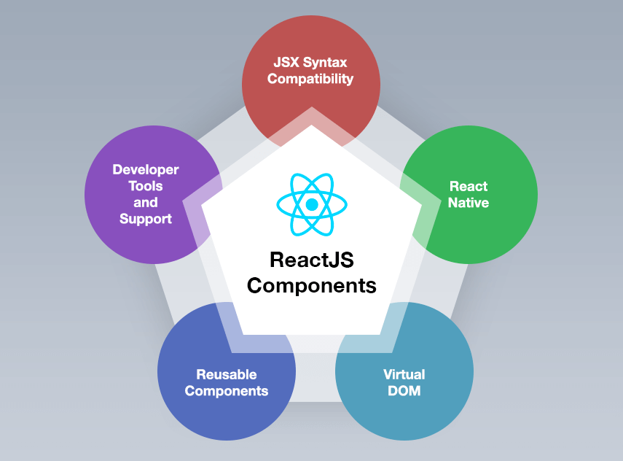
What is ReactJS ?
JavaScript is a library not a FrameWork
ReactJS design according to the MVC model
React is the most popular JavaScript library for building user interfaces.

Slide 9

What is MySQL ?
MySQL is one of the world’s most popular databases.
* Easy to use
* High security
* Multi-features
* Compatible on many operating systems
* Allow restore

Slide 10
1.
Project function description &Lesson learned

Slide 11
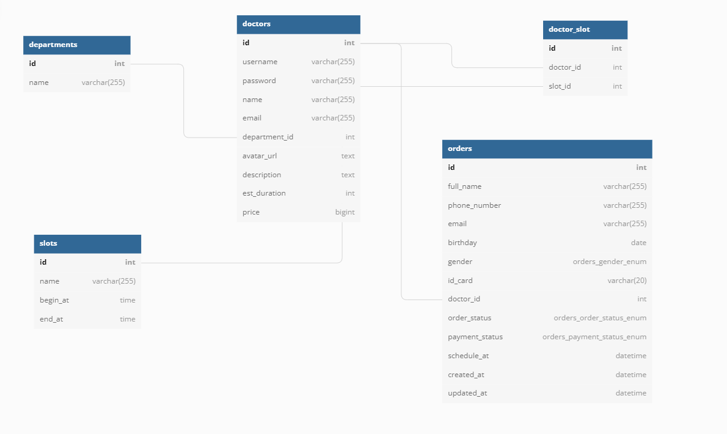
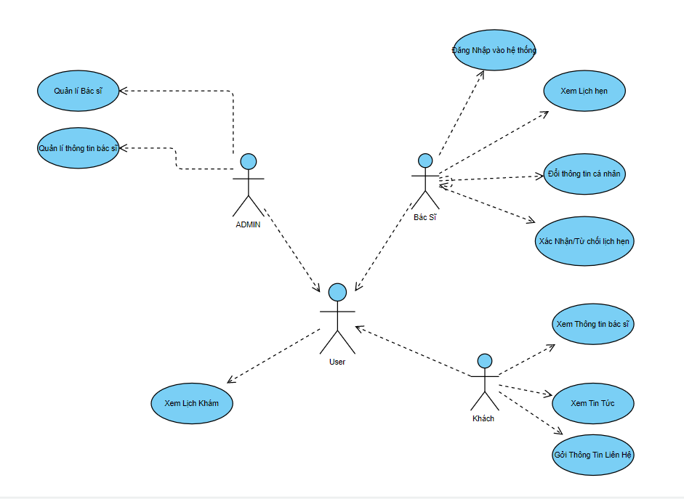
System Functions
Entity Relationship Diagram
User Case Diagram

Slide 12
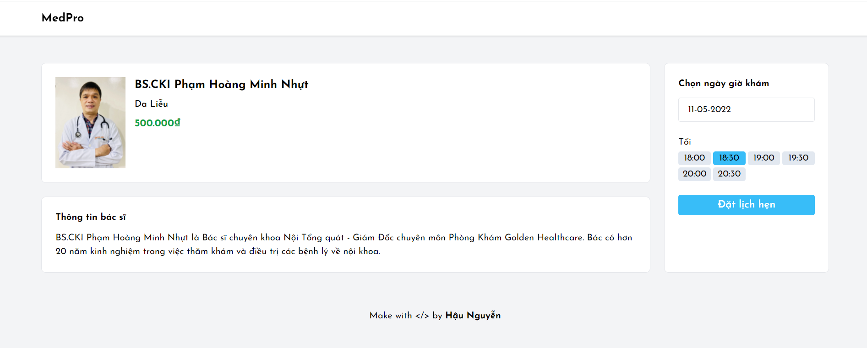
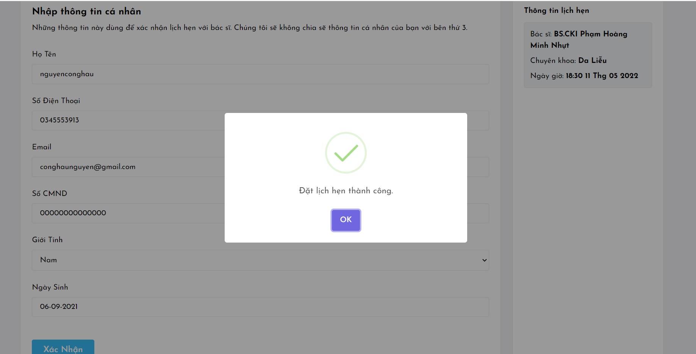
System Functions
* Appointment interface for medical examination

Slide 13
System Functions
* The customer page displays a list of specialties, view doctor details
* Customers can book a specific appointment
* The doctor page can edit the doctor's information, accept or decline the appointment
* Admin page to manage doctors

Slide 14

Results learnt
Teamwork
Code Style & Optimize code
Design UI
Git, Gitlab, GitHub
MySql
Database
Spring boot
ReactJS
System Analysis and Design

Slide 15
Trainning Project management tools & agile methodology
Trainning Work Etiquette & Professional Communication & Email writing
Trainning Security Awareness
Presentation Skills

Slide 16
1.
DEMO

Slide 17


